Slide 1
Cloud Computing
Dr. Md. Nasim Adnan

Slide 2
Capacity Planning
A system uses resources to satisfy its computing demands from cloud that include processor, memory, storage, and network capacity.
Each of these resources has a utilization ceiling, and one or more of these resources my reach ceilings when demand increases and that in turn limits performance.
It is the goal of a capacity planner to identify the critical resource that has this ceiling and to add more resources to move the bottleneck to higher levels of demand.
Scaling a system can be done by scaling up vertically to more powerful systems or by scaling out horizontally to more but less powerful systems. This is a fundamental architectural decision that is affected by the types of workloads that cloud computing systems are being asked to perform. This chapter presents some of these tradeoffs.

Slide 3
Many people equate capacity planning with system optimization (or performance tuning, if you like), but they are not the same.
System optimization aims to get more production from the system components you have. Capacity planning measures the maximum amount of work that can be done using the present system and then adds resources to do more work if needed.
If system optimization occurs during capacity planning, that is all to the good; but capacity planning efforts focus on meeting demand.
If that means the capacity planner must accept the inherent inefficiencies in any system, so be it.

Slide 4
Capacity planning is an iterative process with the following steps:
Determine the characteristics of the present system.
Measure the workload for the different resources in the system: CPU, RAM, Disk, Network, and so forth.
Load the system until it is overloaded, determine when it breaks, and specify what is required to maintain acceptable performance. Knowing when systems fail under load and what factor(s) is responsible for the failure is the critical step in capacity planning.
Predict the future based on historical trends and other factors.
Deploy or tear down resources to meet your predictions.
Iterate Steps 1 through 5 repeatedly.

Slide 5
Baseline Measurements
Let’s assume that a capacity planner is working with a system that has a web site based on APACHE, and let’s assume the site is processing database transactions using MySQL.
There are two important overall workload metrics in the aforementioned system:
Page views or hits on the web site, as measured in hits per second
Transactions completed on the database server, as measured by transactions per second
or perhaps by queries per second.
In the next Figure, the historical record for the Web server page views over a hypothetical day, week, and year are graphed.

Slide 6
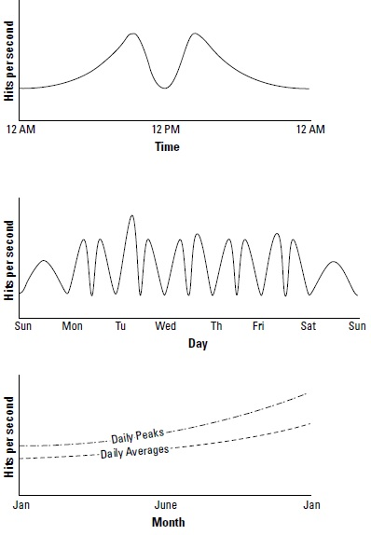

Slide 7
A number of important statistics can be determined:
W_{T}, the total workload for the system per unit time. To obtain W_{T}, you need to integrate the area under the curve for the time period of interest.
W_{AVG}, the average workload over multiple units of time. To obtain W_{AVG}, you need to sum various W_{T}s and divide by the number of unit times involved. You may also want to draw a curve that represents the mean work done.
W_{MAX}, the highest amount of work recorded by the system. This is the highest recorded system utilization. In the middle graph of the previous Figure, it would be the maximum number recorded on Tuesday morning.
W_{TOT}, the total amount of work done by the system, which is determined by the sum of W_{T}(ΣW_{T}).

Slide 8
Similar statistics can be determined for the Database server, with the workload for those servers measured in transactions per second.
As part of the capacity planning exercise, the workload for the Web servers would be correlated with the workload of the Database servers to determine patterns of usage.
The goal of a capacity planning exercise is to accommodate spikes in demand as well as the overall growth of demand over time.
Of these two factors, the growth in demand over time is the most important consideration because it represents the ability of a business to grow. A spike in demand may or may not be important enough for an activity to capture its characteristics.
Baseline measurements can be aggregate for more than one servers in an infrastructure.

Slide 9
System Metrics
A server (physical or virtual) is primarily defined by four essential resources:
CPU
Memory (RAM)
Disk
Network connectivity
Each of these resources can be measured by tools that are operating-system-specific. In Linux/ UNIX, you might use the sar command to display the level of CPU activity. sar is installed in Linux as part of the sysstat package.
In Windows, a similar measurement may be made using the Task Manager, the data from which can be dumped to a performance log and/or graphed.

Slide 10
Examining your server under normal condition isn’t going to give enough information to do meaningful capacity planning. We need to know what happens to a system when the load increases. Load testing seeks to answer the following questions:
What is the maximum load that the current system can support?
Which resource(s) represents the bottleneck in the current system that limits the system’s performance?
This parameter is referred to as the resource ceiling. Depending on a system’s configuration, any resource can have a bottleneck removed, and the resource ceiling then passes onto another resource.
Can I alter the configuration of my server in order to increase capacity?
How does this server’s performance relate to your other servers that might have different characteristics?

Slide 11
Capacity planners will equate different system statistics of essential resources.
They also need to equate whether a spike will cause a bottleneck or not…

Slide 12
We can use load balancer to test a servers’ resource ceilings. This technique has the dual advantages to slowly increment traffic on a server and to use real requests while doing so.
Most load balancers allow you to weight the requests going to a specific server with the goal of serving more requests to more powerful systems and fewer requests to less powerful systems.
Sometimes the load balancer does this optimization automatically, and other times you can exert manual control over the weighting.
Whatever method we use to load a server for performance testing, you must pick a method that is truly representative of real events, requests, and operations.

Slide 13
Resource Ceilings
Whatever performance measurement tool you use, the goal is to create a set of resource utilization curves similar to the ones shown in the next Figure for individual server types in your infrastructure.
To do this, you must examine the server at different load levels and measure utilization rates.
The graphs in the next Figure indicate that over a certain load for a particular server, the CPU (A), RAM (B), and Disk I/O (C) utilization rates rise but do not reach their resource ceiling. In this instance, the Network I/O (D) reaches its maximum 100-percent utilization at about 50 percent of the tested load, and this factor is the current system resource ceiling.

Slide 14
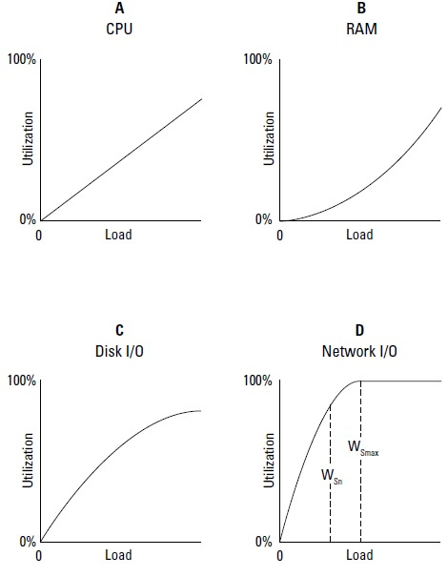

Slide 15
Network I/O is often a bottleneck in Web servers, and this is why, architecturally, Web sites prefer to scale out using many low-powered servers instead of scaling up with fewer but more powerful servers.
Adding more (multi-homing) or faster network connections can be another solution to improving Web servers’ performance.

Slide 16
Unless you alter the performance of the server profiled in the previous Figure to improve it, you are looking at a maximum value for that server’s workload of W_{Smax}, as shown in the dashed line at the 50-percent load point in graph D.
At this point, the server is overloaded and the system begins to fail. Some amount of failure may be tolerable in the short term, provided that the system can recover and not too many web hits are lost, but this is a situation that you really want to minimize.
You can consider W_{Sn} to be the server’s red line, the point at which the system should be generating alerts or initiating scripts to increase capacity.

Slide 17
One goal of capacity planning is to make growth and shrinkage of capacity predictable. You can greatly improve your chances by standardizing on a few hardware types and then well characterizing those platforms. Reducing the variability between servers makes it easier to troubleshoot problems and simpler to deploy and configure new systems.
As much as possible, you also should assign servers standardized roles and populate those servers with identical services. A server with the same set of software, system configuration, and hardware should perform similarly if given the same role in an infrastructure.

Slide 18
If any cloud-computing system resource is difficult to plan for, it is Network capacity.There are three aspects to assessing network capacity:
Network traffic to and from the network interface at the server, be it a physical or virtual
Network traffic from the cloud to the network interface
Network traffic from the cloud through your ISP to your local network interface (your computer)
For a cloud-based virtual server, the network interface may be a highly variable resource as the cloud vendor moves virtual systems around on physical systems or reconfigures its network pathways on the fly to accommodate demand.

